Slide 1

Financial Fraud Analysis Executive Summary
Anthony LaRosa

Slide 2
Background
In 1992 approximately 0.18% of all payment activity was fraudulent, today, it is near 5%
As the digital age progressed, a greater percentage of an individual’s identity was moved online
Identify theft is continuing to rise across the globe
Data science has found commercial successes in fraud detection, saving the organization money and reputation

Slide 3
Problem Statement and Scope
This project will:
Examine the (24) million transactions from the bank
Create a fraud detection program
Differentiate between various financial feature types occurring at the bank
The bank tellers are currently able to detect fraud 50% of the time with the objective of this project to engage the customer
Utilize data science principles
Create fraud detect software that exceeds the 50% success rate of the tellers
The types of financial transactions in scope are as follows:
CASH-IN
CASH-OUT
DEBIT
PAYMENT
TRANSFER

Slide 4
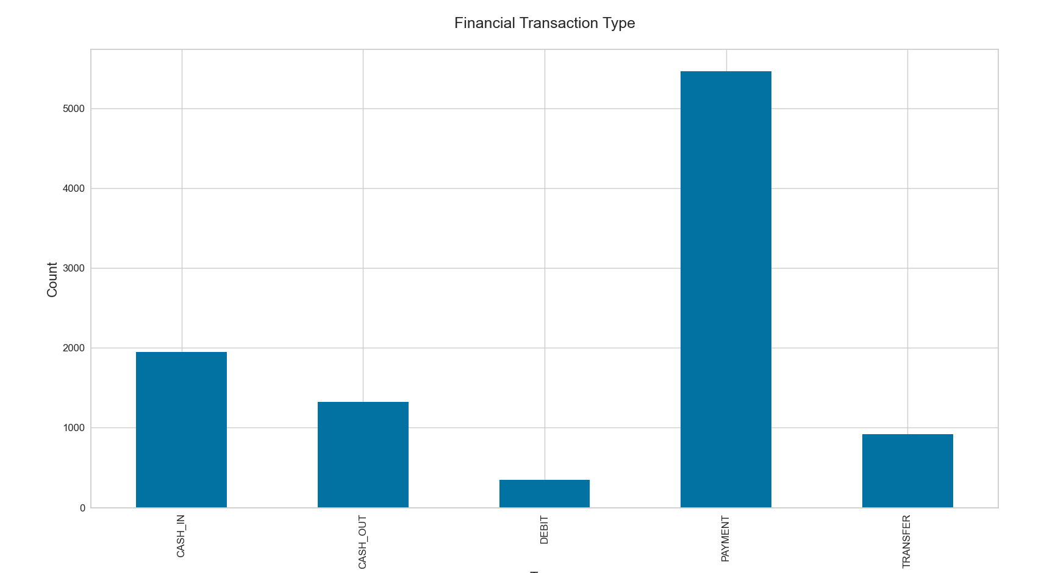
Technical Approach: EDA
A count of the financial transaction type demonstrates the spread of the sample set

Slide 5
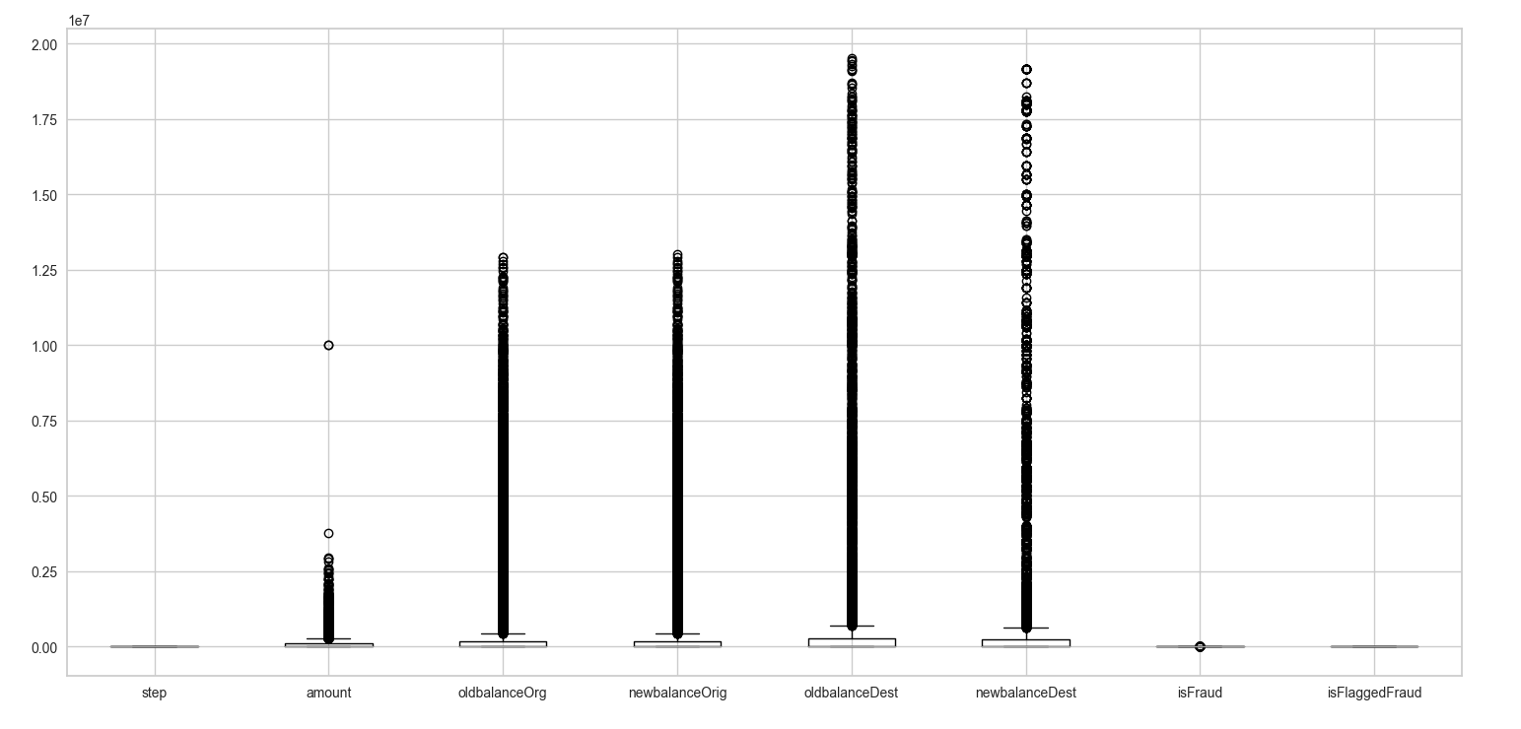
Technical Approach: EDA Cont.
Creating boxplots of the features assists in identifying outliers

Slide 6
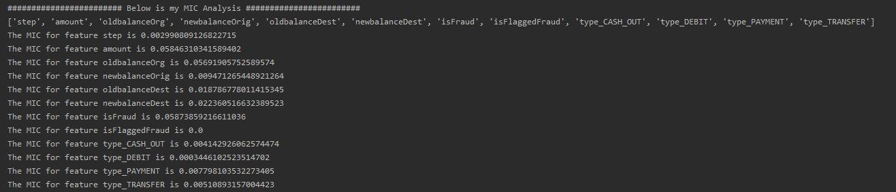
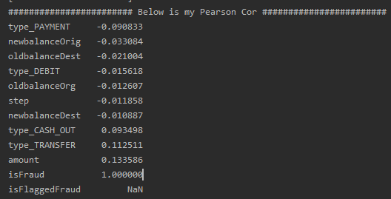
Technical Approach: Model Building
Performed a Pearson Correlation and MIC Analysis for Feature Building
Utilized the following features:
amount
oldbalanceOrg
newbalanceOrig
oldbalanceDest
newbalanceDest
type_DEBIT
type_PAYMENT
type_TRANSFER

Slide 7
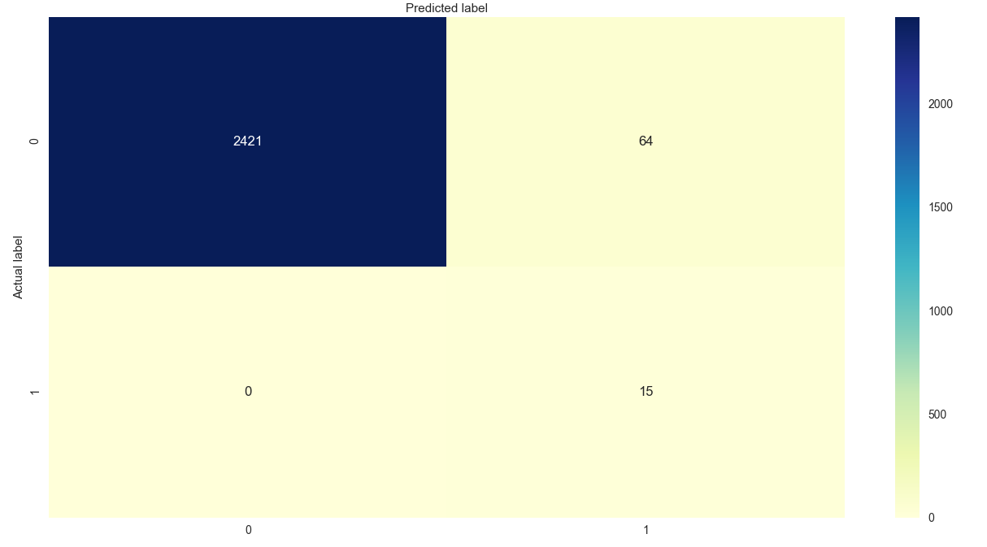
Technical Approach: Model Assessment
Below is the matrix for our logistic regression model
No false negatives
64 false positives

Slide 8

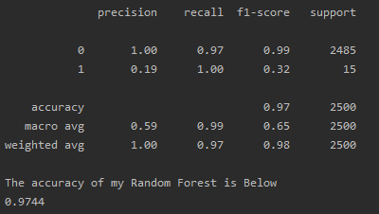
Technical Approach: Model Assessment Cont.
Below is the results from the Random Forest
Utilized 1000 estimators
Achieved 97% Accuracy and Summarized the Performance Metrics below

Slide 9
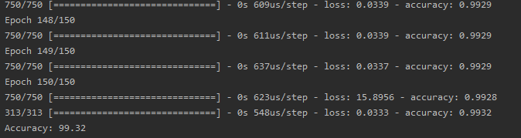
Technical Approach: Model Assessment Cont.
Below is the results from the KERAS Neural Network
Best performing model
Achieved 99% Accuracy

Slide 10
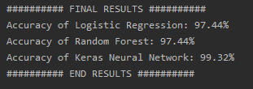
Final Results
Below are the results from the (3) Models
The Random Forest and Logistic Regression were equal
The KERAS Neural Network resulted in the best performance
The Machine Learning was able to meet the objective in the problem statement and accurately detect fraud more than 50% of the time

Slide 11
Issues and Challenges
Feature Reduction
Categorical data needed to be converted to numeric data
Converting the data frame using dummies resulted in over 16,000 columns
Utilized REGEXP to reduce features in two lines of code
Hardware Constraints
Unable to run over 100,000 rows of the 600,000 row sample set
Increased challenge of performance metrics
Accuracy is not the best indicator in largely imbalanced classes

Slide 12
Next Steps
Feature Engineering
Review with technical lead (Professor Werner) current feature engineering and consider potential changes or improvements
Feature Selection
Discuss and review the optimal selection of features that were compiled to build the model
Model Tuning
Discuss with technical lead if additional tuning can occur or use of other modeling techniques to decrease the false positive rate from the matrix table

Slide 13
Citation
Financial fraud. (2017, August 15). Retrieved February 15, 2021, from https://www.fbi.gov/news/stories/florida-estate-planner-sentenced-in-financial-fraud-case
Horan, T. (2014). Evolution of Fraud Analytics – An Inside Story. Retrieved January 18, 2021, from https://www.kdnuggets.com/2014/03/evolution-fraud-analytics-inside-story.html

